Slide 1
K.R. Mangalam University
School of Engineering and Technology
Department:-CSE
Session:- Odd
Programme:- B.Tech CSE (Specialisation with AI/ML)
Semester:- 1st
Course Code: ETCCCP105
Course Name:- Computer Science Fundamentals &
Career Pathways
Faculty:- Mr. Rajesh
Assignment No. 02 :- Basics of Linux and Oen source tools.
Assignment Title :- How can You Demonstrate Linux Setup, Command Usage, and Automation Through Practical Implementation?
Name:- Pravindra Singh
Roll no. :- 2501730132

Slide 2
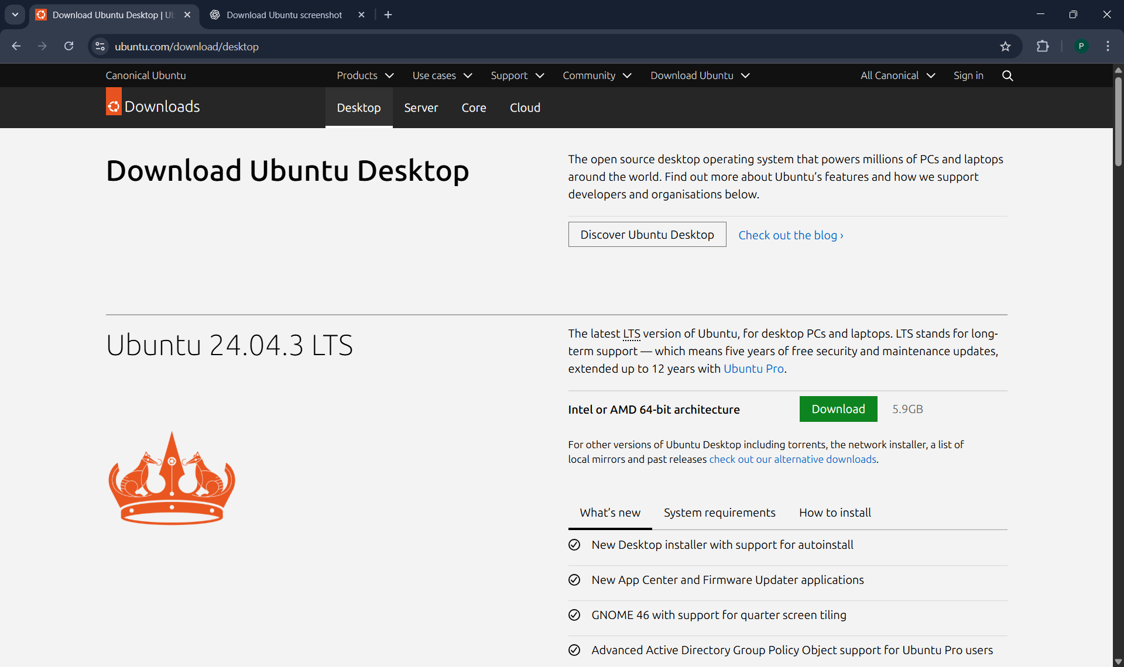
1.Introduction:-
Linux is a versatile and open-source operating system widely used in academic, research, and enterprise environments. This assignment focuses on learning Linux installation, essential commands, and shell scripting for automation. The objective is to develop practical skills applicable to DevOps, system administration, and software engineering.
2.Ubuntu Installation using virtualBox:-
Ubuntu 22.04 LTS was installed using Oracle VirtualBox. The following configuration was used: RAM - 4GB, CPU - 2 Cores, Disk Space - 25GB. The steps were:
1.Download Ubuntu ISO file from official website:-

Slide 3
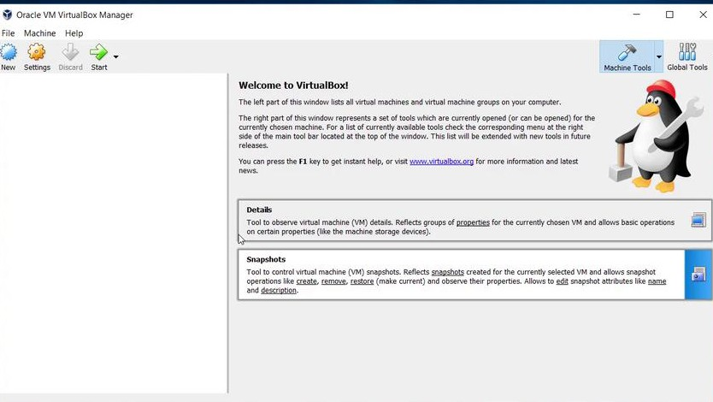
2. Create a new Virtual Machine in VirtualBox.
3.Allocate hardware resources and attach iso in VirtualBox.
4. Install Ubuntu with default settings.
5. Update packages and reboot system.

Slide 4
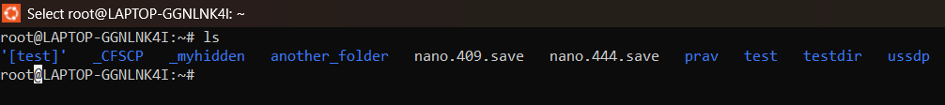
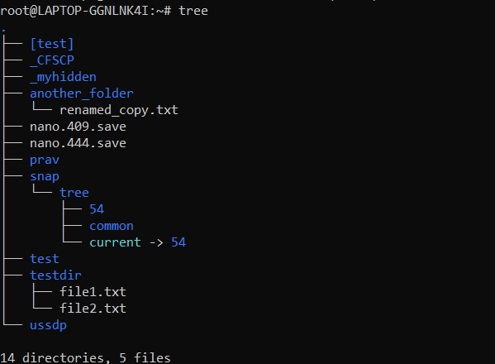
3.Shell command demonstration :-
The following table includes 20 essential Linux commands demonstrating file navigation, file management, permissions, process control, and networking utilities :-
1.Command: ls
Description: Lists files and directories
Syntax: ls Usage: Displays contents of the current directory.
2.Command: cd
Description: Changes current directory.
Syntax: cd Documents
3.Command: pwd .
Description: Shows current working directory.
Syntax: pwd .
4.Command: tree.
Description: Displays directory structure
Syntax: tree

Slide 5
5.Command: mkdir
Description: Creates new directory
Syntax: mkdir test_folder
6.Command: touch
Description: Creates new file
Syntax: touch file1.txt .
7.Command: cp .
Description: Copies files or directories.
Syntax: cp file1.txt file2.txt .
8.Command: mv
Description: Moves or renames files
Syntax: mv file1.txt docs/ .
9.Command: rm
Description: Removes files or directories
Syntax: rm file2.txt
10.Command: chmod
Description: Changes file permissions
Syntax: chmod 755 script.sh
11.Command: chown
Description: Changes file ownership
Syntax: sudo chown user:user file.txt

Slide 6
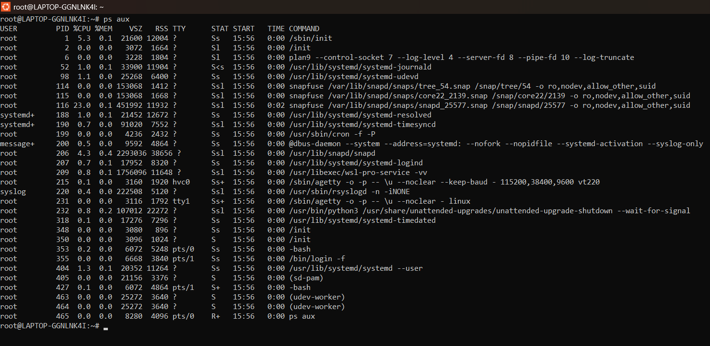
12.Command: ps
Description: Displays active processes
Syntax: ps aux

Slide 7
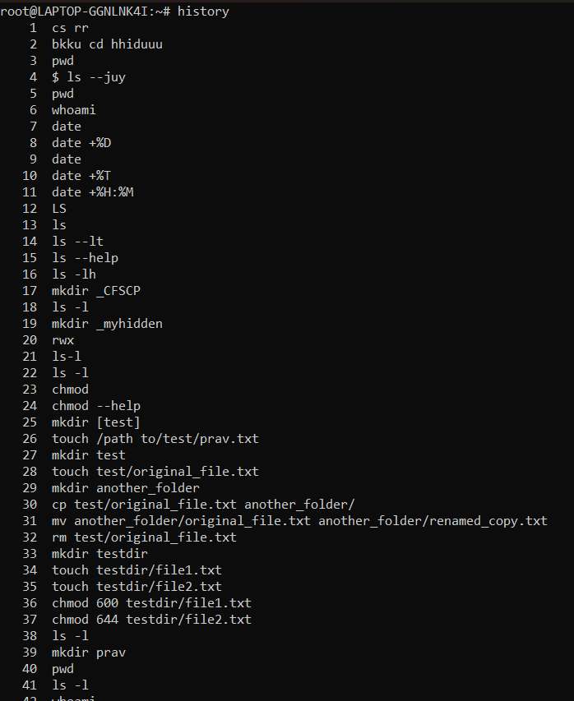
13.Command: top
Description: Monitors system processes
Syntax: top
14.Command: kill
Description: Terminates a process
Syntax: kill 1234
15.Command: ping
Description: Tests network connectivity
Syntax: ping google.com
16.Command: ifconfig
Description: Displays network configuration
Syntax: ifconfig
17.Command: ip
Description: Manages network interfaces
Syntax: ip addr show
18.Command: netstat
Description: Shows network statistics
Syntax: netstat -tuln
19.Command: history
Description: Displays command history
Syntax: history

Slide 8
20.Command: clear
Description: Clears terminal screen
Syntax: clear Usage: Removes clutter from terminal view.
4. GitHub Repository Submission :-
A GitHub repository named ‘linux-shell-assignment-sem-1’ was created to host all three shell scripts.
Link:- pravindrasingh6002-star/linux-shell-assignment-sem-1
5. Reflection and Learning Outcomes:-
This assignment enhanced understanding of Linux environment management, command line utilities, and automation using shell scripting. Challenges included handling permissions and debugging shell scripts. Through this exercise, I learned to effectively use Linux for real-world automation, backups, and system monitoring — essential skills for future software and AI projects.

